Slide 1
File Transfer
Protocol
(FTP)

Slide 2
FTP uses the services of TCP.
It needs two TCP connections.
The well-known port 21 is used
for the control connection
and the well-known
port 20 for the data connection.

Slide 3
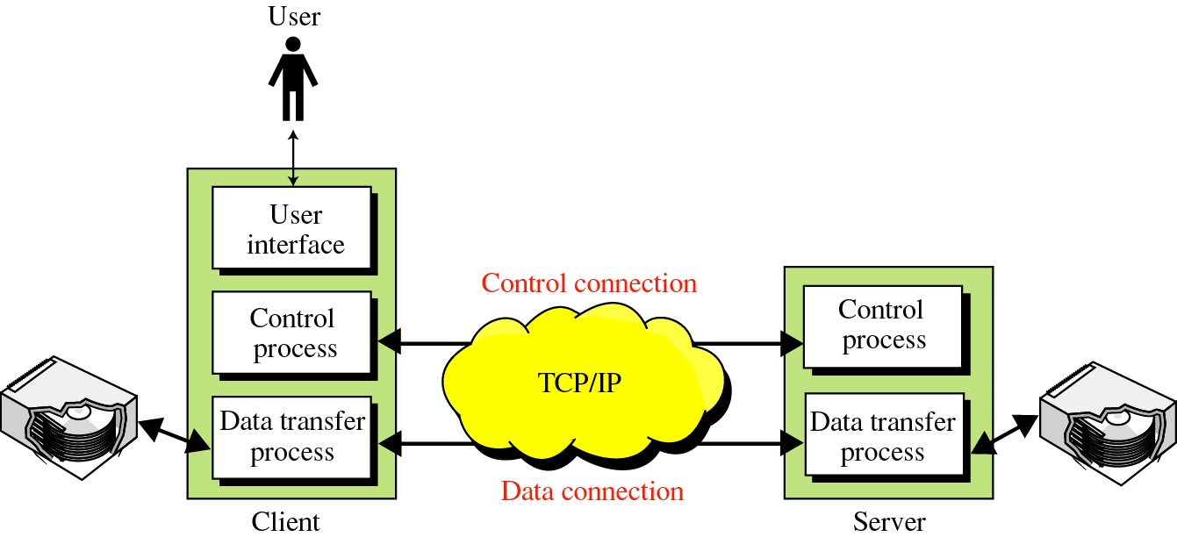
Figure 20-1
FTP

Slide 4
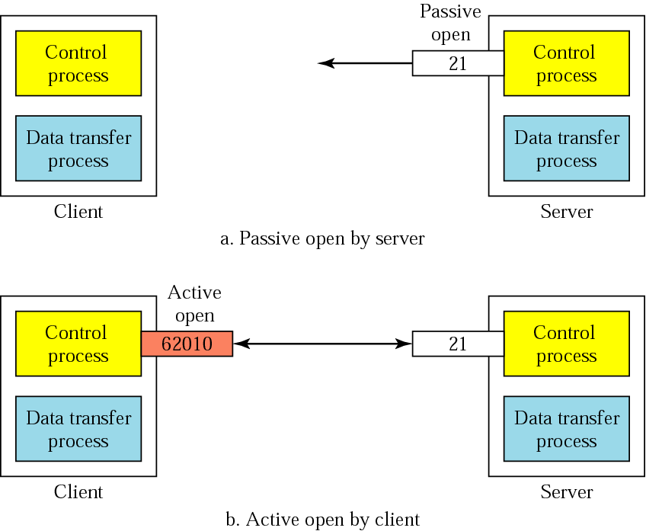
20.1 Connections: The control connection

Slide 5
The Data Connection
Uses Server’s well-known port 20
Client issues a passive open on an ephemeral port, say x.
Client uses PORT command to tell the server about the port number x.
Server issues an active open from port 20 to port x.
Server creates a child server/ephemeral port number to serve the client

Slide 6
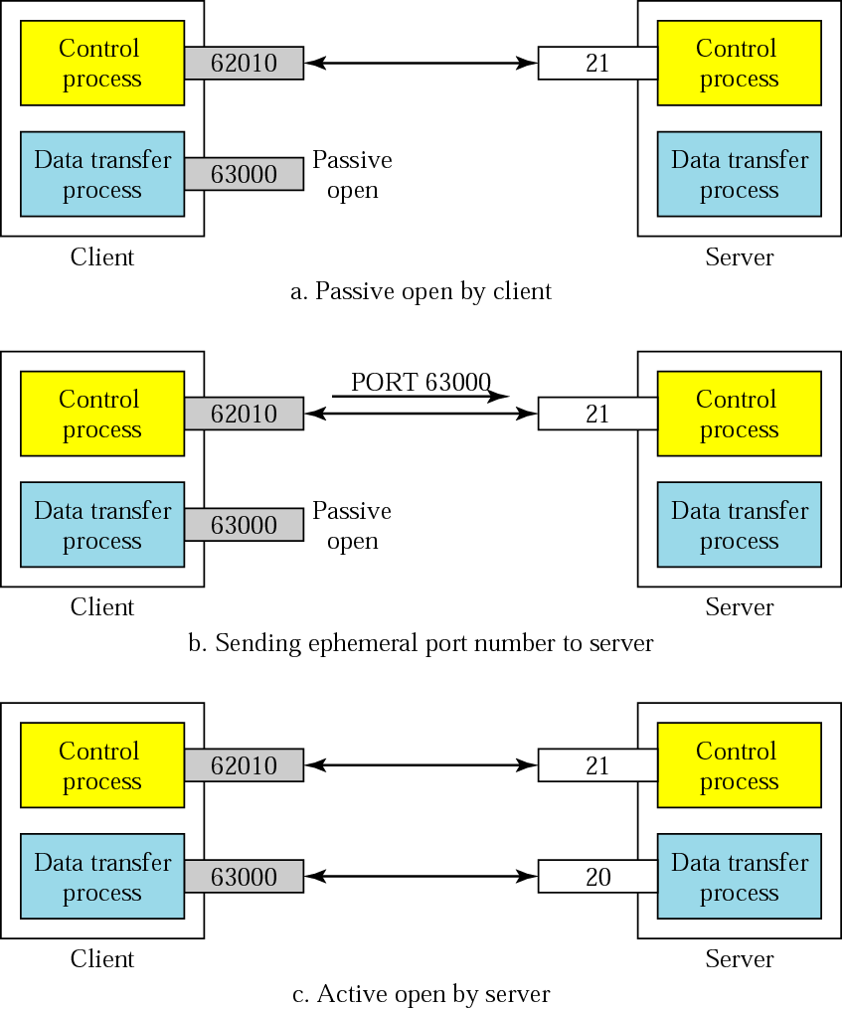
Creating
the data
connection

Slide 7
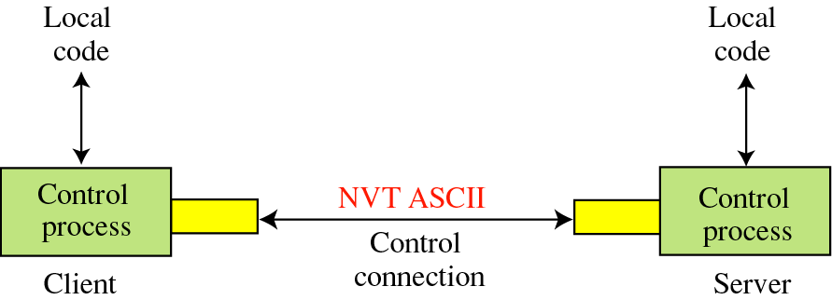
Figure 20-4
20.2 Communication
Using the control connection

Slide 8
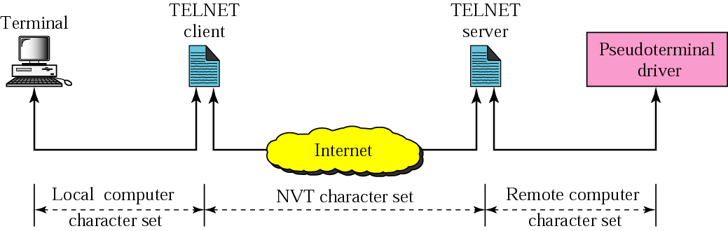
NVT
FTP
FTP

Slide 9
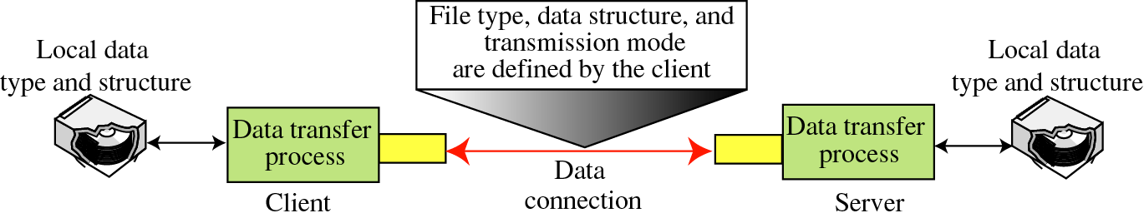
Figure 20-5
Using the data connection

Slide 10
File Type
ASCII or EBCDIC
  Nonprint
  TELNET
Image

Slide 11
Data Structure
File Structure
Record Structure
Page Structure

Slide 12
Transmission Mode
Stream mode
Block mode
Compressed mode

Slide 13
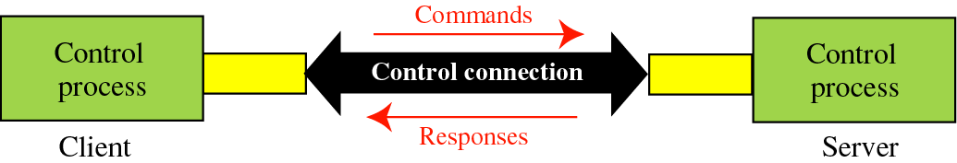
20.3 Command processing
Access Commands
File Management
Data Formatting
Port defining
File transfer
Miscellaneous

Slide 14
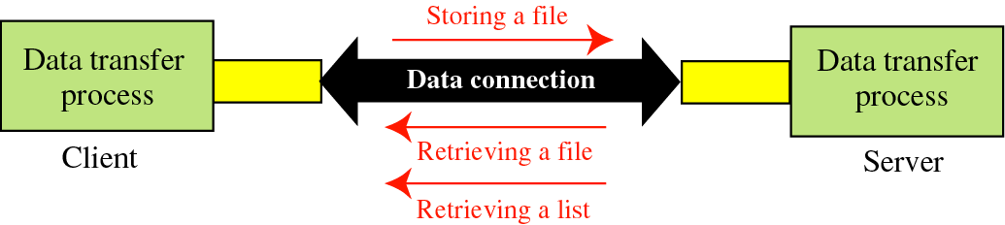
20.4 File transfer

Slide 15
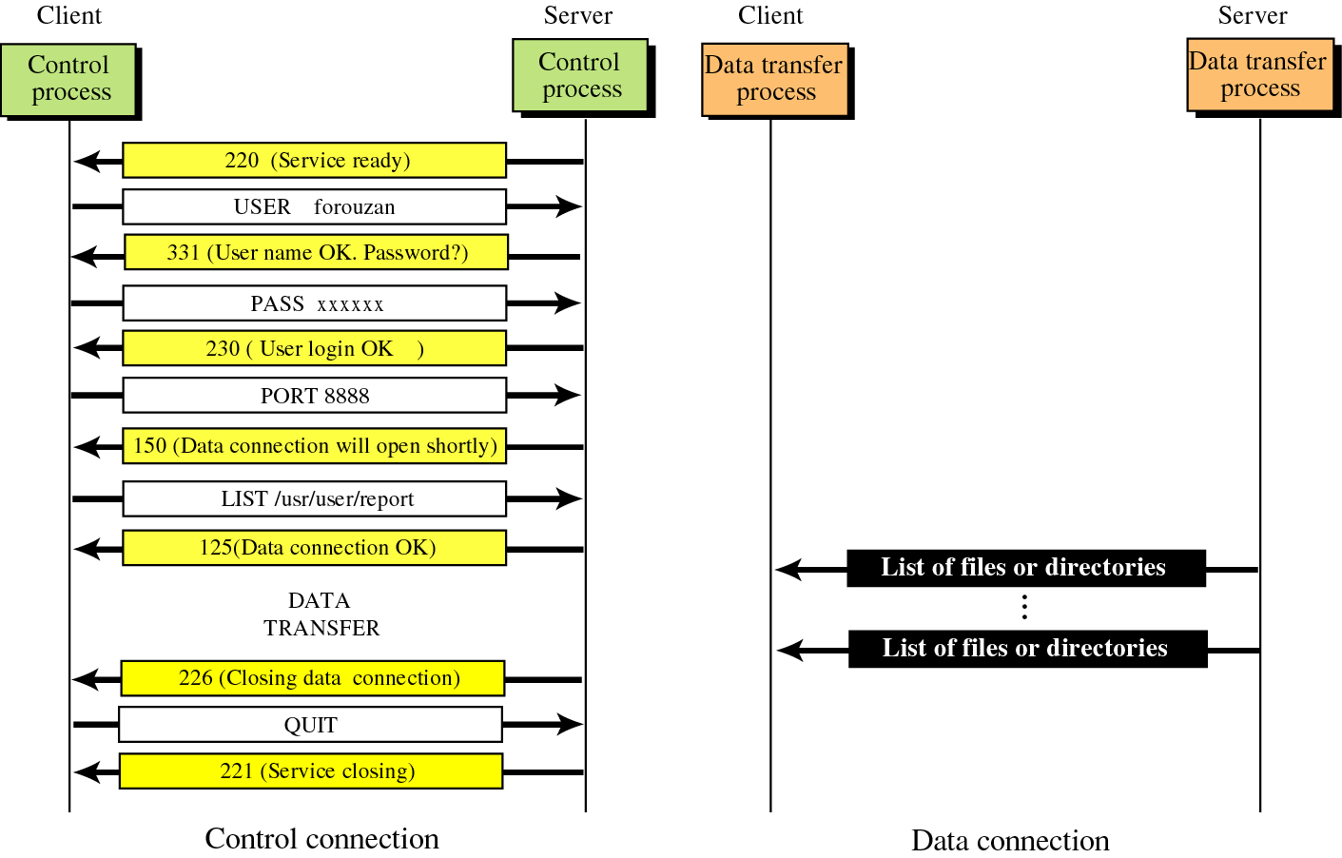
Figure 20-8
Example 1

Slide 16
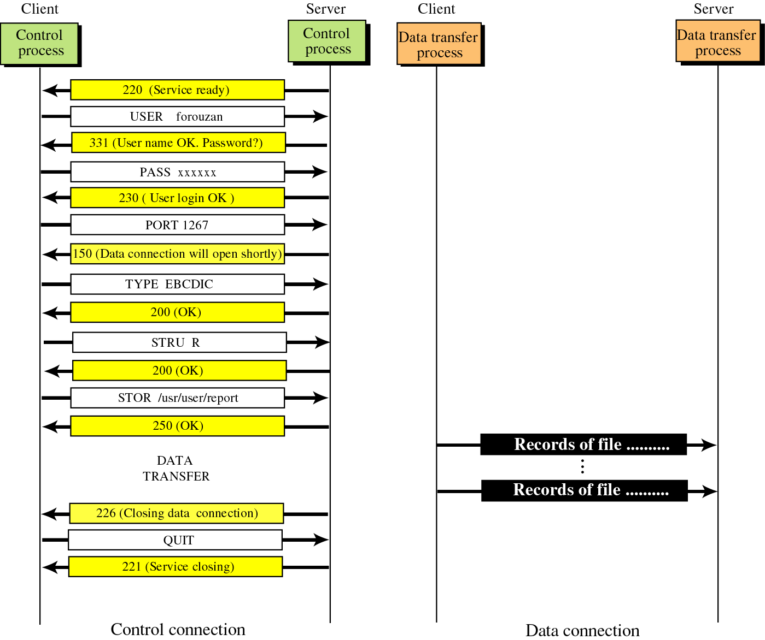
Figure 20-9
Example 2

